Slide 1

APEX INSTITUTE OF TECHNOLOGY
DEPARTMENT OF COMPUTER SCIENCE & ENGINEERING
Artificial Intelligence (20CSD-385)
Faculty: Ankur Sharma(E13693)
Lecture – 1.3.4&1.3.5
Heuristic Search Techniques
DISCOVER . LEARN . EMPOWER

Slide 2
Artificial Intelligence : Course Objectives
COURSE OBJECTIVES
(AI) is a research field that studies how to realize the intelligent human behaviors on a computer. The ultimate goal of AI is to make a computer that can learn, plan, and solve problems autonomously. Although AI has been studied for more than half a century, we still cannot make a computer that is as intelligent as a human in all aspects, The main research topics in AI include: problem solving, reasoning, planning, natural language understanding, computer vision, automatic programming, machine learning, and so on. Of course, these topics are closely related with each other. In this course, we will study the most fundamental knowledge for understanding AI. We will introduce some basic search algorithms for problem solving; knowledge representation and reasoning; pattern recognition; fuzzy logic; and neural networks

Slide 3
COURSE OUTCOMES
On completion of this course, the students shall be able to:-
CO1 | Understand the basics of the theory and practice of Artificial Intelligence as a discipline and about intelligent agents capable of problem formulation
CO2 | Apply different uninformed search algorithms on well formulate problems along with stating valid conclusions that the evaluation supports.

Slide 4
Unit-1 Syllabus
Unit-1
Ch1.Introduction to AI | Introduction Artificial Intelligence and its applications, Artificial Intelligence Techniques, Intelligent Agents, Nature of Agents, Learning Agents., advantages, and limitations of AI, Application of AI.
Ch2.Searching techniques | Problem solving techniques State space search, control strategies, Blind search
Ch3.Informed search | Heuristic search, problem characteristics, production system characteristics., Generate and test, Hill climbing, best first search, A* search, Constraint satisfaction problem.

Slide 5
SUGGESTIVE READINGS
TEXT BOOKS
T1. Artificial Intelligence: A Modern Approach by Stuart Russell and Peter Norvig. Prentice-Hall, 2003 (2ndEdition). T2. Elaine Riche, Kevin Knight and Shivashankar B. Nair, “Artificial Intelligence”, Third Edition, TMH Educations Pvt. Ltd., 2008
REFERENCE BOOKS
R1 Nils J. Nilsson, “The Quest for Artificial Intelligence”, Second Edition, Cambridge University Press, 2009
R2 Artificial Intelligence and Expert Systems – Dan W. Patterson, Prentice Hall of India

Slide 6
Heuristic Search Techniques
Direct techniques (blind search) are not always possible (they require too much time or memory).
Weak techniques can be effective if applied correctly on the right kinds of tasks.
Typically require domain specific information.

Slide 7
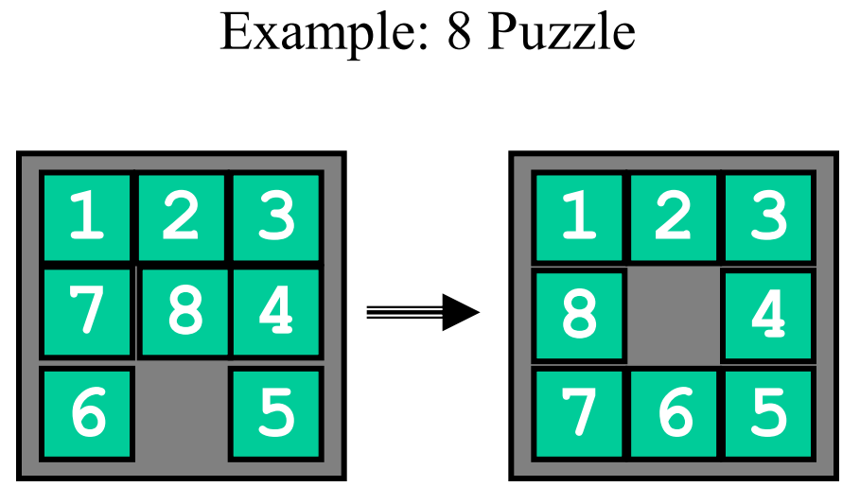
Heuristic Search Techniques

Slide 8
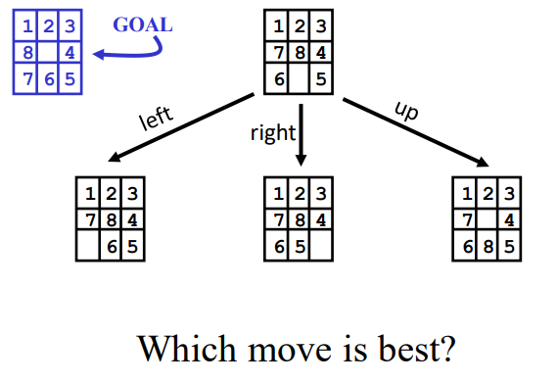
Heuristic Search Techniques

Slide 9
8 Puzzle Heuristics
Blind search techniques used an arbitrary ordering (priority) of operations.
• Heuristic search techniques make use of domain specific information - a heuristic.
• What heurisitic(s) can we use to decide which 8-puzzle move is “best” (worth considering first).

Slide 10
Heuristic Search Techniques
• For now - we just want to establish some ordering to the possible moves (the values of our heuristic does not matter as long as it ranks the moves).
• Later - we will worry about the actual values returned by the heuristic function.
• Number of tiles in the correct position.
– The higher the number the better.
– Easy to compute (fast and takes little memory).
– Probably the simplest possible heuristic.

Slide 11
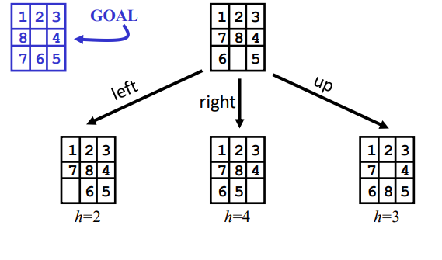
Another approach
• Number of tiles in the incorrect position. – This can also be considered a lower bound on the number of moves from a solution! – The “best” move is the one with the lowest number returned by the heuristic. – Is this heuristic more than a heuristic (is it always correct?).
• Given any 2 states, does it always order them properly with respect to the minimum number of moves away from a solution?

Slide 12
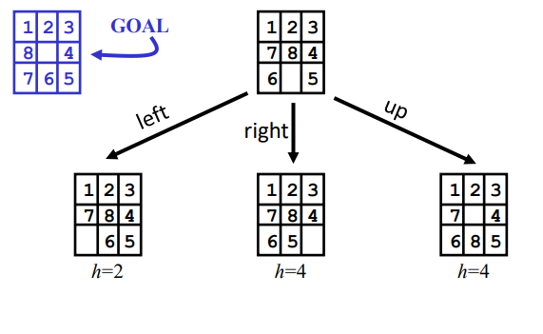
Another 8-puzzle heuristic
• Count how far away (how many tile movements) each tile is from it’s correct position.
• Sum up this count over all the tiles.
• This is another estimate on the number of moves away from a solution.

Slide 13
Heuristic Search Techniques
• There are a variety of search techniques that rely on the estimate provided by a heuristic function.
• In all cases - the quality (accuracy) of the heuristic is important in real-life application of the technique!

Slide 14
Generate-and-test
• Very simple strategy - just keep guessing.
do while goal not accomplished
generate a possible solution
test solution to see if it is a goal
• Heuristics may be used to determine the specific rules for solution generation.

Slide 15
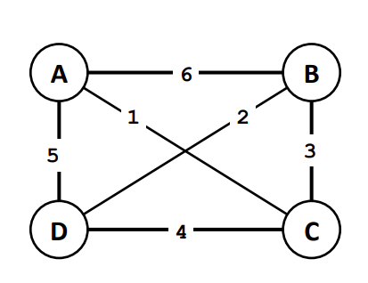
Example - Traveling Salesman Problem (TSP)
• Traveler needs to visit n cities.
• Know the distance between each pair of cities.
• Want to know the shortest route that visits all the cities once.
• n=80 will take millions of years to solve
exhaustively!

Slide 16
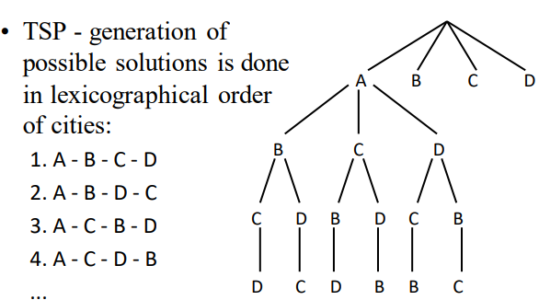
Generate-and-test Example

Slide 17
Simulated Annealing
• Based on physical process of annealing a
metal to get the best (minimal energy) state.
• Hill climbing with a twist:
– allow some moves downhill (to worse states)
– start out allowing large downhill moves (to
much worse states) and gradually allow only
small downhill moves.

Slide 18
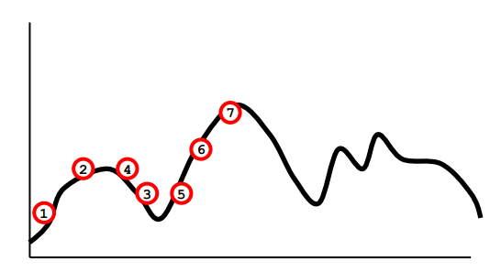
Simulated Annealing (cont.)
• The search initially jumps around a lot, exploring many regions of the state space.
• The jumping is gradually reduced and the search becomes a simple hill climb (search for local optimum).

Slide 19
REFERENCES
Artificial Intelligence: A Modern Approach by Stuart Russell and Peter Norvig. Prentice-Hall, 2003 (2nd Edition).

Slide 20
THANK YOU
For queries
Email: Ankur.e13693@cumail.in

